Slide 1
Decision Analysis in IDS

Slide 2

CONTENTS
What is Decision Analysis?
Introduction
Decision Analysis Model
What is Intrusion Detection System(IDS)?
Introduction
Signature Based IDS
Anomaly Based IDS
Case Study: Appling Decision Analysis Process to IDS
Example: Selling your product
Example: USS Cole Bombed
Conclusion
References

Slide 3
DECISION ANALYSIS(DA)

Slide 4
Coined by Ronald Howard(1964), professor of Management and Engineering at Stanford University
Evaluates options
Involves complex analysis
Quantitative
Interactive
Systematic

Slide 5
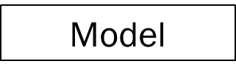
What we want?
Model
What are you trying to achieve?
What do you want?
What do you want?
Goal
What we can do?
Goal
Decision Criteria
Alternatives
Constraints

Slide 6

INTRUSION DETECTION SYSTEM

Slide 7

Monitors suspicious activities
Creates alarms/alerts
Comes in various flavours
IDS
NIDS
HIDS

Slide 8


SIGNATURE BASED
Has a DB of signatures of malicious threats
There is potential threat to your system
Lag time problem
Has an established baseline
Looks for anomalies
Alerts the Administrator
ANAMOLY BASED

Slide 9

CASE STUDY: Applying Decision Analysis Process to IDS

Slide 10

DETECTION
DECISION ANALYSIS
Sense the adversary
Assessment of the event
Delay action
Response action
Establish a decision board
Frame the problem
Develop alternatives
Evaluate the tradeoffs
Discuss the results and associated risks.

Slide 11

Larger City
Your City
Smaller City
Your Product

Slide 12
Alternatives
Payoffs
Larger City
Smaller City
Same City
Yes
No
Alternatives | Favourable(Yes) | Unfavourable(No)
Larger City | 200000 | -180000
Smaller City | 100000 | -20000
No City(Same City) | 0 | 0

Slide 13
Alternatives | Favourable | Unfavourable | Maximax | Maximin | Minimax
Larger City | 0 | 180000 | 200000 | 180000 | 180000
Smaller City | 100000 | 20000 | 100000 | 20000 | 100000
No City | 200000 | 0 | 0 | 0 | 200000
Max-Payoff
200000 – 200000
200000 – 100000
200000 - 0
Optimistic
Pessimistic

Slide 14
DECISION MAKING ENVIRONMENT
Certainty
Risk
Uncertainty
FC
200000
1
UC
-180000
LC
100000
Sell
SC
FC
2
UC
20000
NC
3
0

Slide 15
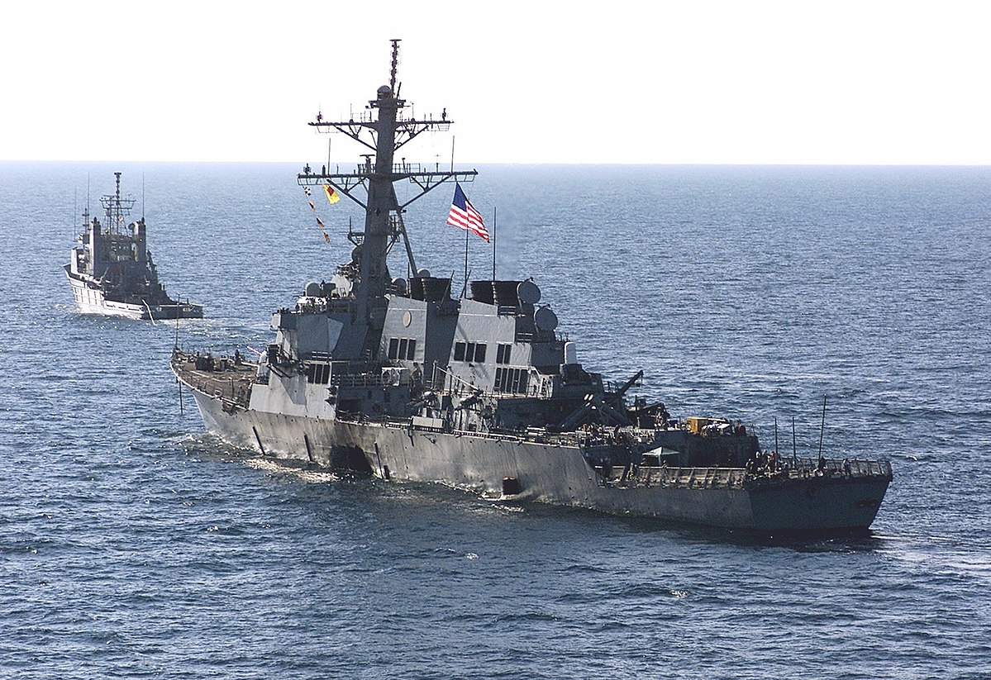
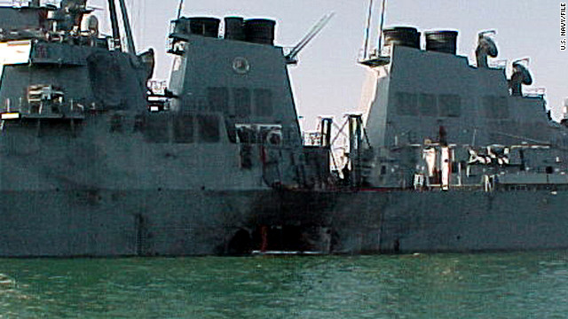
On October 12, 2000, the USS Cole, a U.S. Navy destroyer, was attacked by a small boat loaded with explosives, while refueling in Aden Harbor, Yemen
At 5:15am, suicide bombers aboard a small craft attacked the USS Cole, resulting in an explosion that tore a gaping hole,20 feet by 40 feet, killing 17 sailors and injuring 39.

Slide 16
CONCLUSION
The decision board’s perspectives matter. It is important to understand their objectives and constraints.
Disagreement between security design team members will occur and while having everyone consensus is desirable, it is not mandatory.
Making good decisions do not always guarantee good outcomes when dealing with uncertainty, e.g., changes in security technologies, environmental conditions, and available resources.

Slide 17
References
H.Lin, D.Burnett, D.Sheaffer, E.Arnold, “Applying Decision Analysis Process to Exterior Physical Security System Technology Design and Selection”, 978-1-4244-4170, 2009 IEEE
T.Ben-Zvi, J.V.Nickerson, “Intruder Detection: An Optimal Decision Analysis Strategy”, IEEE Transactions on Systems,Man and Cybernetics, Vol.42 No. 2, March 2012
https://www.lifewire.com/introduction-to-intrusion-detection-systems-ids-2486799

Slide 18


